Slide 1
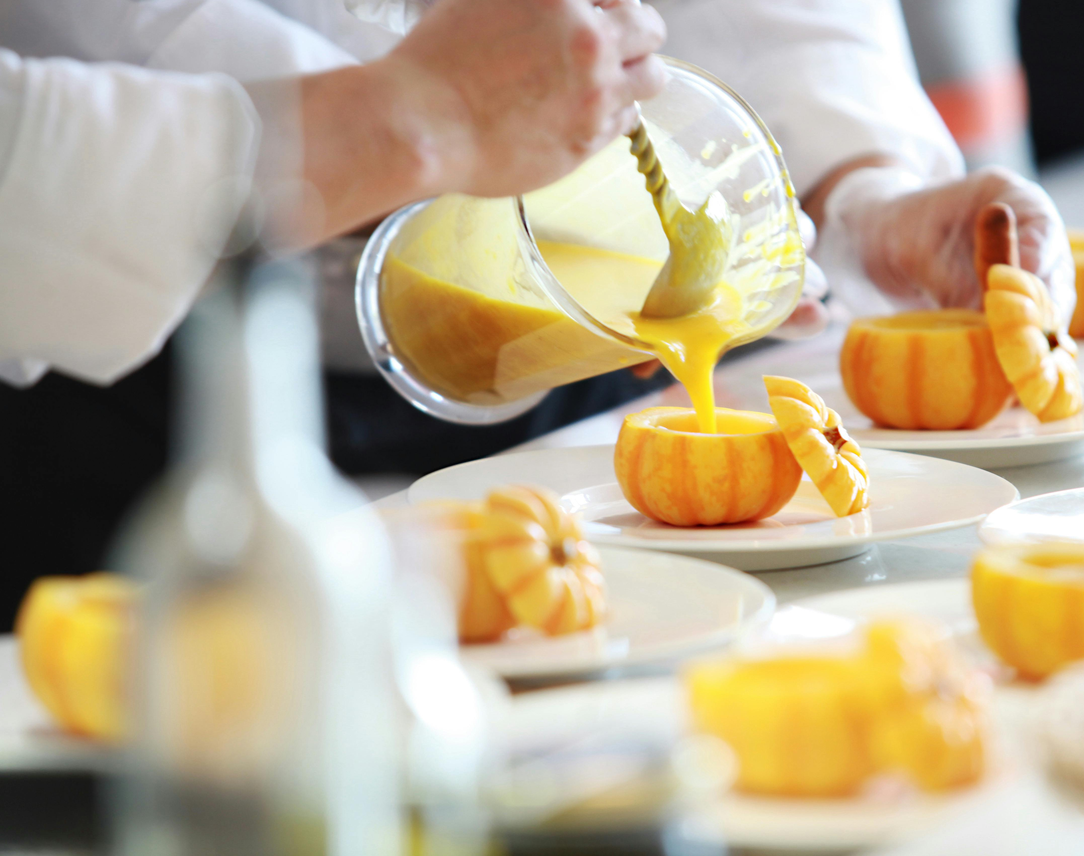
Bon Appétit
Bringing Flavors to Life by Zahra and Saleha

Slide 2
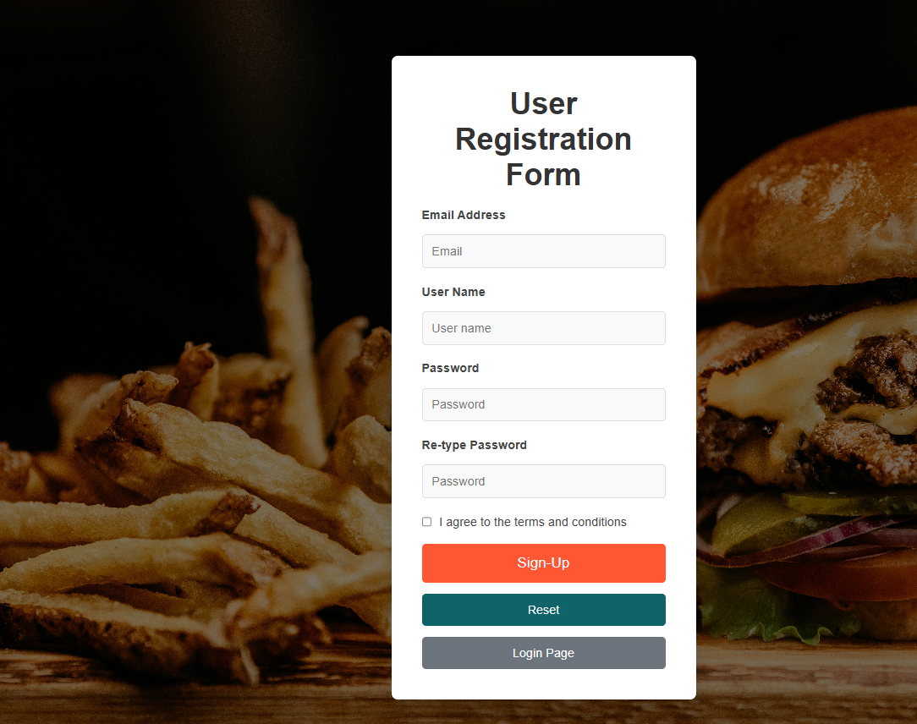
Sign-Up

Slide 3
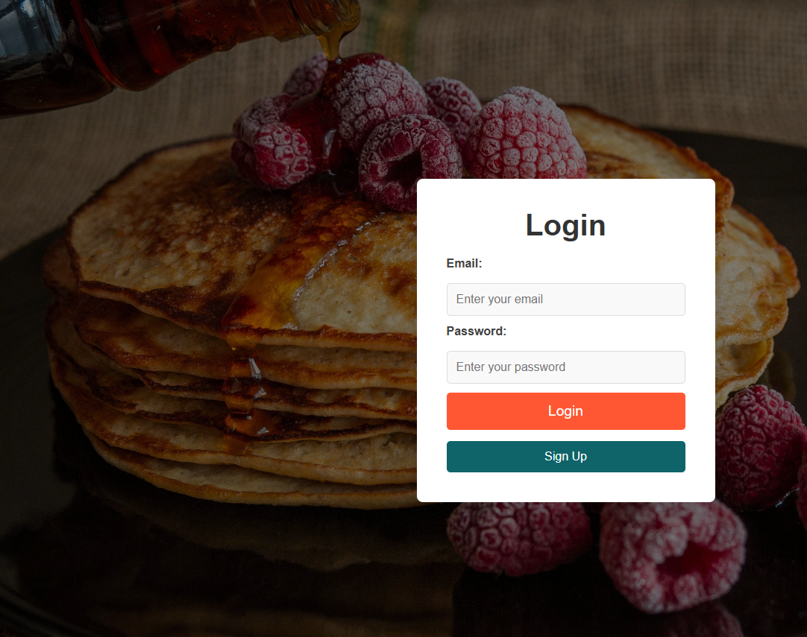
Login

Slide 4
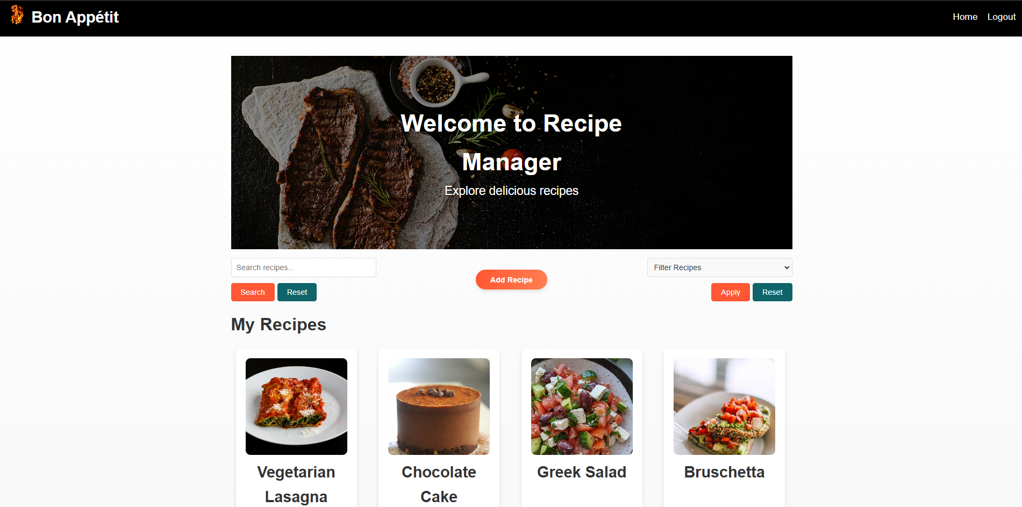
Home

Slide 5
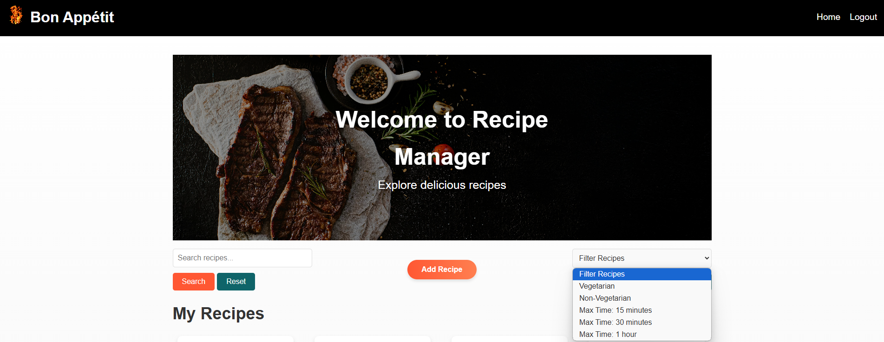
Search & Filter Search provides a dynamic search across all recipes Filters: Time, Vegetarian or Non-Vegetarian

Slide 6
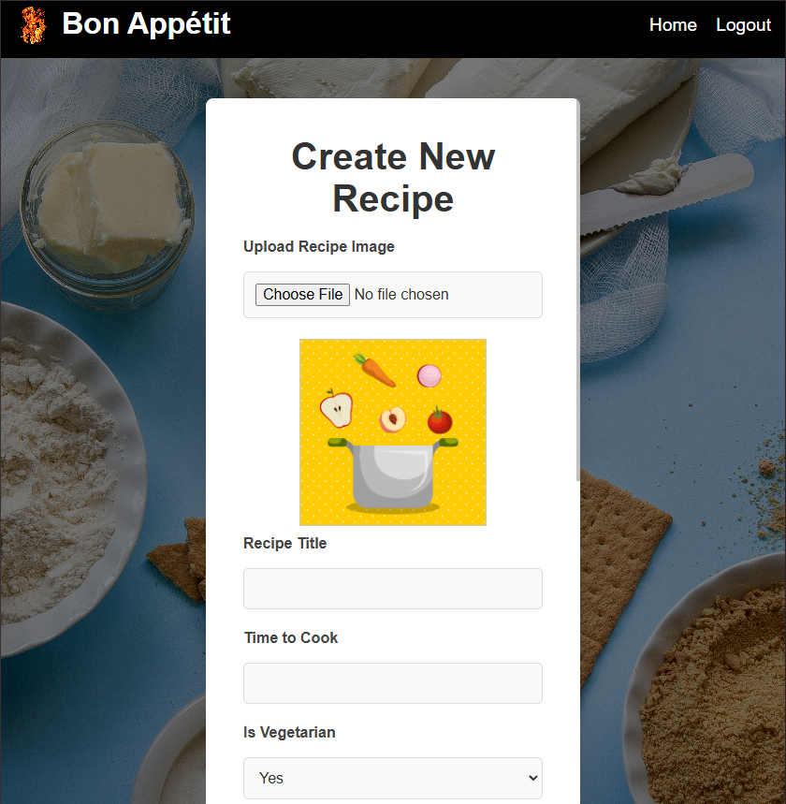
Create New Recipe

Slide 7
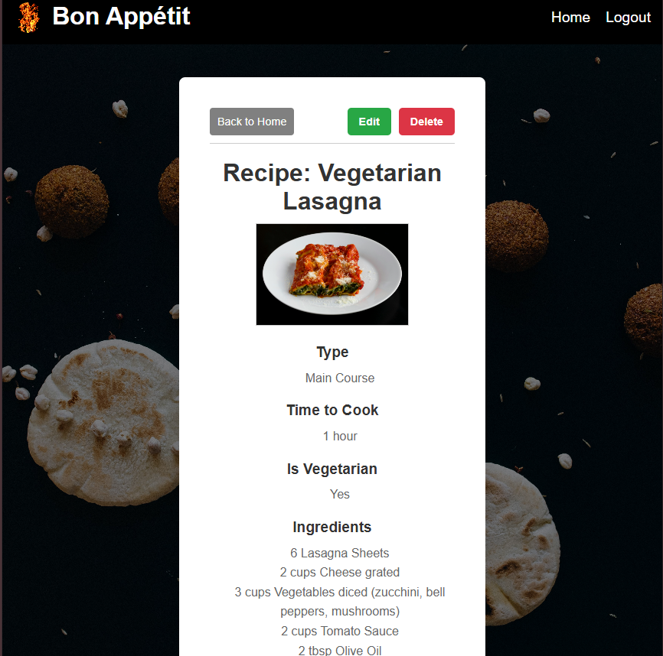
View Recipe

Slide 8
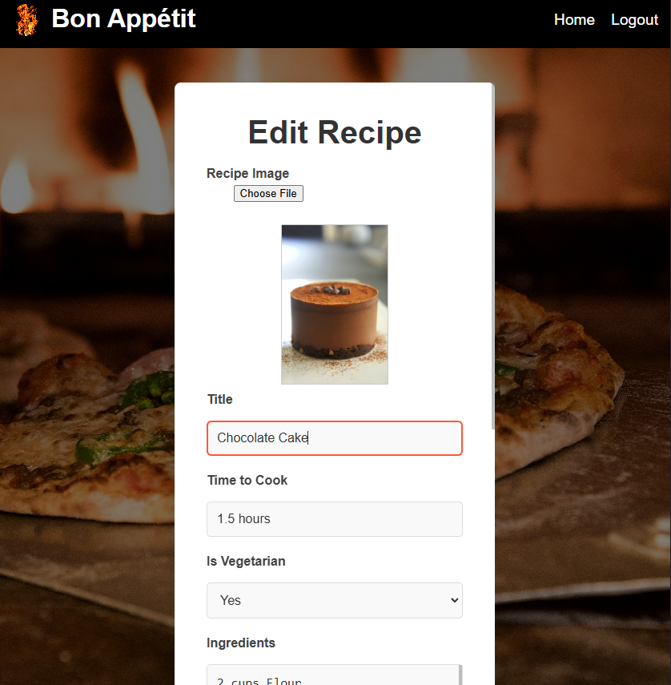
Edit Recipe

Slide 9
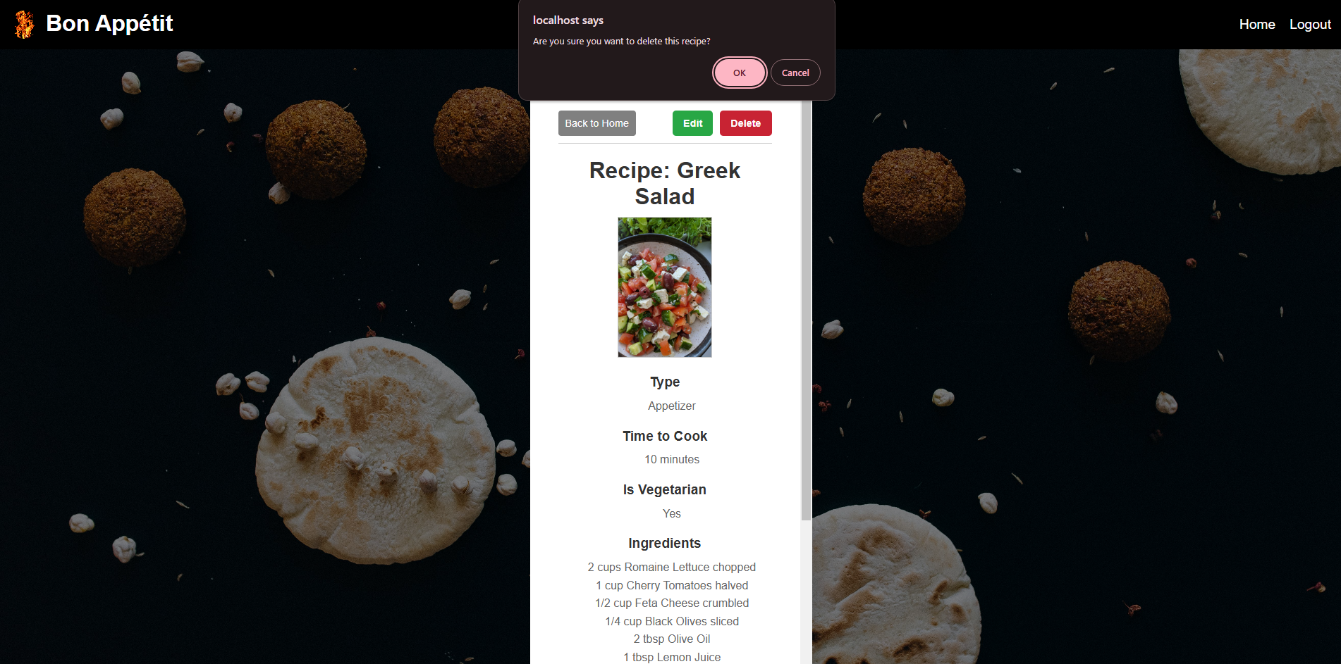
Delete Recipe

Slide 10

Responsive Layout: Laptop/Desktop

Slide 11
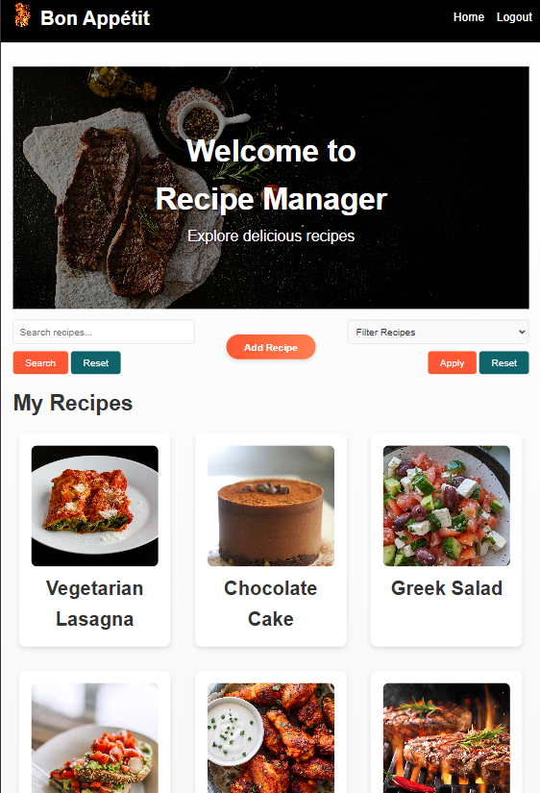
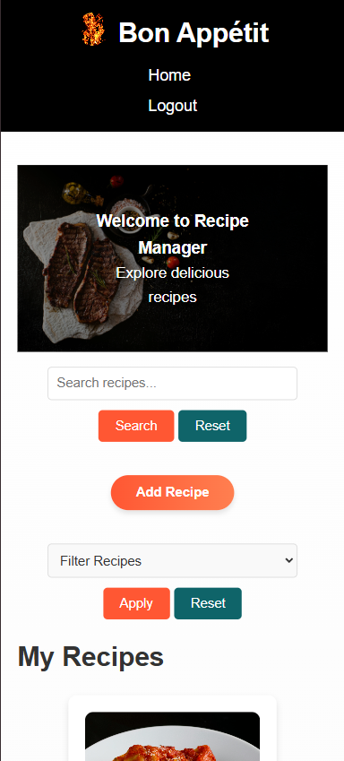
Tablet Mobile

